Slide 1


Enhanced Locker Security
System Using Arduino
THEME: Public Safety
By,
SoC A5 -(Batch No.2)
C.UDAY KUMAR REDDY VTU26481
S.YASWANTH VTU26360
N.MURALI KRISHNA VTU25758
K.GOPALA KRISHNA REDDY VTU26508
K.SAI PAVAN VTU25916
K.SHIVA SHANKAR REDDY VTU26267
Guided by,
Priscilla Whitin
Asst prof / EEE
M . Karthick
Asst prof / Mech
Vel Tech Rangarajan Dr.Sagunthala R & D Institute of Science & Technology

Slide 2
ABSTRACT :
Security systems are essential for protecting assets, yet traditional lock-and-key mechanisms often fail to prevent unauthorized access effectively. Existing methods primarily use audible alarms or basic surveillance systems, which lack real-time response capabilities. Our proposed solution, the laser security call alert system, combines precise laser detection with GSM-based call alerts to enhance locker security. The system uses invisible laser beams as tripwires; when these beams are interrupted, an LDR sensor detects the breach and signals an Arduino microcontroller. This activates an alarm and sends an instant call alert via the SIM800L GSM module, ensuring immediate notification of security breaches. By integrating laser sensors and GSM communication, our system provides a robust, real-time, and scalable security solution, addressing the limitations of traditional methods.

Slide 3
LIST OF THEMES:
T-1
ENERGY CONSERVATION
T-2
ROBOTICS
T-3
PUBLIC SAFETY
T-4
AGRICULTURE
T-5
INDUSTRY, INNOVATION AND INFRASTRUTURE
T-6
CLEAN WATER AND SANITATION
T-7
SUSTAINABLE CITIES AND COMMUNITIES
T-8
AFFORDABLE AND CLEAN ENERGY

Slide 4
SELECTED THEME : PUBLIC SAFETY
safety encompasses measures and solutions designed to protect individuals and communities from harm, ensuring a secure environment. With rising security concerns, innovative and reliable systems are crucial for preventing unauthorized access and responding to potential threats efficiently.
Relation to the Project :Our Laser Security Call Alert System enhances public safety by providing a cutting-edge solution for securing sensitive areas, such as lockers, in public and private spaces. Traditional security methods often fall short in providing real-time alerts and precise detection. Our project addresses these issues by using laser technology and GSM communication. When the laser beam is interrupted, the system immediately triggers an alarm and sends a call alert to the owner's phone, ensuring rapid response to any breach. Utilizing an Arduino microcontroller, SIM800L GSM module, laser emitter, and LDR sensor, the system offers a low-cost, high-efficiency security solution that enhances public safety through reliable and immediate threat detection and notification.

Slide 5
EXISTING METHOD
Traditional Lock-and-Key Systems
Traditionally, lockers have been secured using simple lock-and-key mechanisms. These systems rely on mechanical keys and locks to prevent unauthorized access. While cost-effective and straightforward, they are susceptible to being picked, duplicated, or forcibly breached. Moreover, they do not offer any real-time alert or remote monitoring capabilities, making them inadequate for modern security needs.

Slide 6

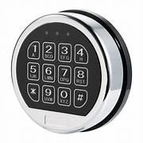
Electronic Keypad Locks
Electronic keypad locks offer a step up from traditional locks by requiring a passcode to unlock. These systems provide better security as they eliminate the risk of lost keys and allow for easy changing of passcodes. However, they still lack real-time alerting and remote monitoring features, which are crucial for promptly responding to security breaches.

Slide 7
PROBLEM IDENTIFICATION
Lack of Immediate Alert:
Many systems do not provide instant notifications to the owner in the event of a breach.
High Costs:
Advanced systems like biometric and smart locks can be prohibitively expensive for some users.
Limited Scalability and Flexibility:
Older security systems may lack scalability, making it difficult to adapt to changing security requirements or expand coverage as needed. This can result in gaps in security coverage or inefficiencies in resource allocation.

Slide 8
PROPOSED METHOD
Our proposed laser security call alert system combines the precision of laser detection with the immediacy of call alerts to provide enhanced locker security. This system utilizes a laser emitter and an LDR (Light Dependent Resistor) sensor connected to an Arduino microcontroller to form an invisible security boundary around the locker. The laser beam travels long distances without scattering and remains mostly invisible, ensuring that it is difficult for intruders to detect and bypass. When the laser beam is interrupted, the LDR sensor detects the change and signals the Arduino to trigger an alarm and spotlight, providing an immediate local response.

Slide 9
Additionally, the system is integrated with a GSM module, which enhances the security by sending real-time alerts via phone call or SMS to predefined phone numbers. This ensures that even if no one is present at the location, the breach is promptly communicated to the owner or security personnel,

Slide 10
enabling a swift response. The continuous monitoring by the LDR sensor and the immediate notification capability of the GSM module address the shortcomings of existing systems, which often lack real-time detection and instant alert features.
The system's design emphasizes cost-effectiveness and efficiency, utilizing readily available components and the programmable flexibility of Arduino. It operates with low power consumption, making it suitable for continuous use. Moreover, the system's scalability allows for the protection of larger and more complex areas by using mirrors to extend the laser path around corners. By integrating precise laser detection with immediate call alerts, our proposed system provides robust and reliable locker security, ensuring comprehensive protection against unauthorized access attempts.

Slide 11
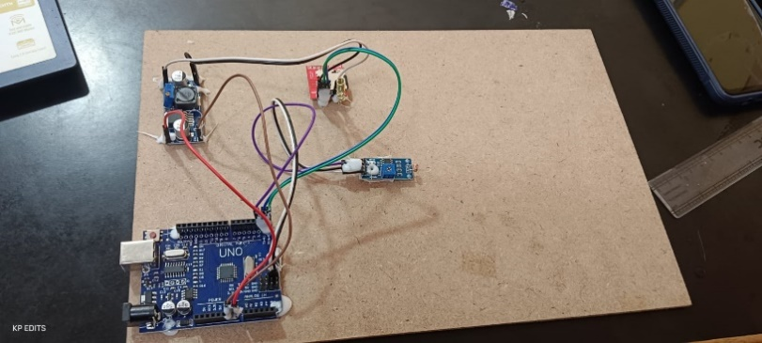

Slide 12
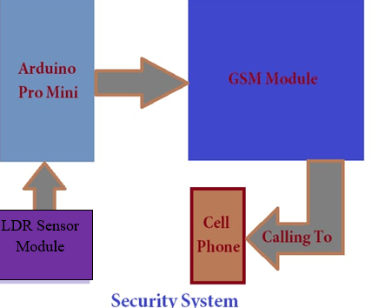
BLOCK DIAGRAM
LED SENSOR MODULE:
The LDR detects changes in light intensity. when the light level changes ,it sends a signal to the Arduino uno

Slide 13
Arduino uno:
The Arduino Uno is the central processing unit of the system. It receives the signal from the LDR Module if the light level has changed or doesn’t receive any signal the Arduino sends the information or gives command to GSM Module
GSM Module:
The GSM is responsible for communication over the mobile network when it receives the command from Arduino it initiates call to a predefined cell phone
Cell Phone:
Then it receives call and alert the owner that someone or something entered

Slide 14
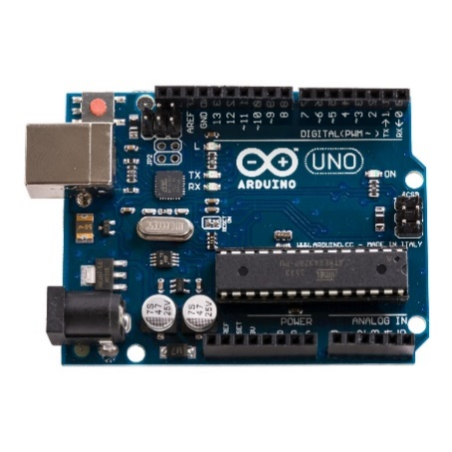
MATERIALS
Arduino board:-
Arduino board is a open source controller board that is good for beginers to learn electronic and coding

Slide 15
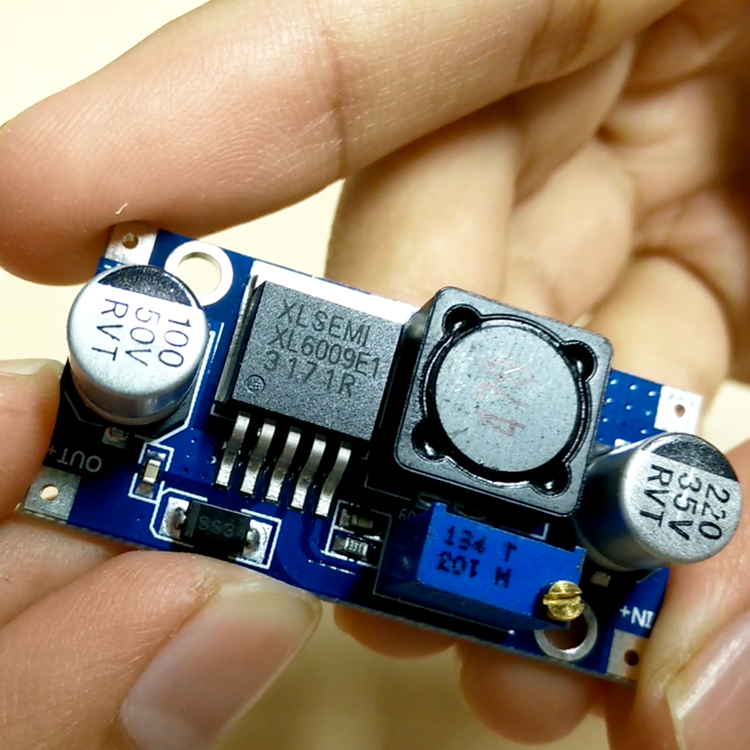
Bulk and booster module:
The buck–boost converter is a type of DC-to-DC converter that has an output voltage magnitude that is either greater than or less than the input voltage magnitude

Slide 16
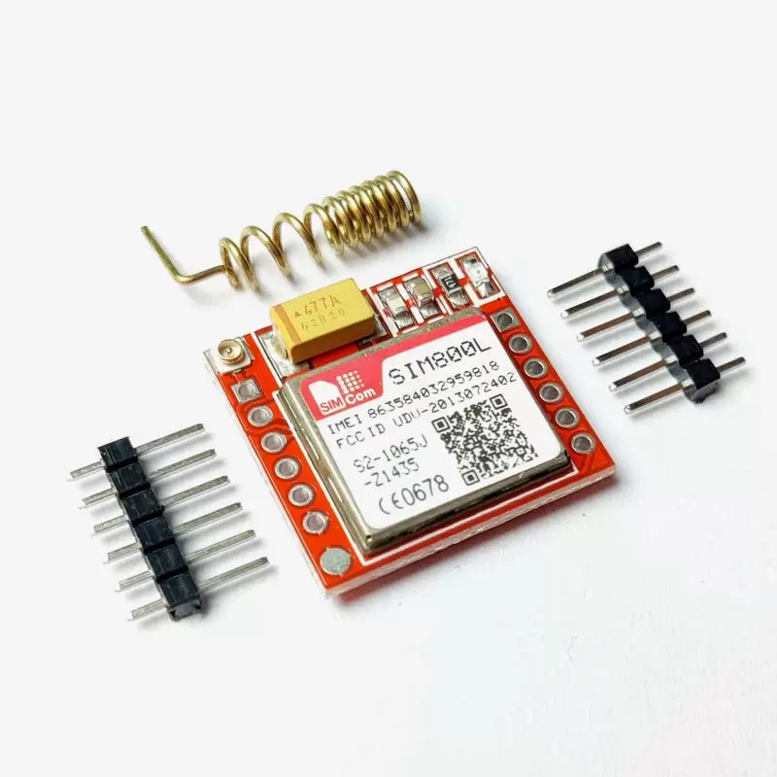
Sim 800L(GPRS):
SIM800L is a miniature cellular module which allows for GPRS(genral packet radio service) transmission, sending and receiving SMS and making and receiving voice calls. Low cost and small footprint and quad band frequency support make this module perfect solution for any project that require long range connectivity

Slide 17
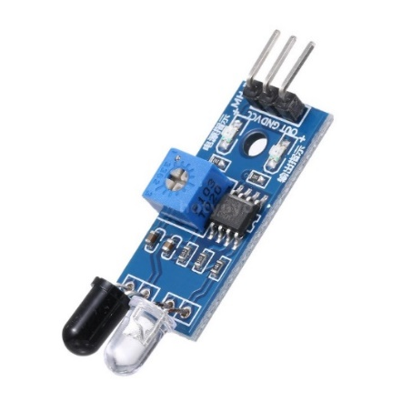
LDR Sensor module:
LDR light sensor modules are used where there is a need to sense the presence and absence of light is necessary.

Slide 18
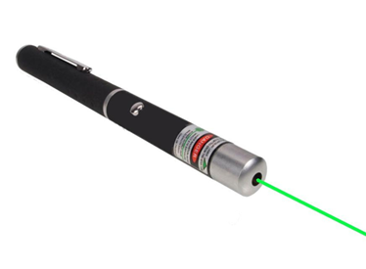
Laser light:
Light amplification by stimulated emission of radiation
A laser is a device that emits a beam of coherent light through an optical amplification process

Slide 19
HARDWARE PROTOTYPE
The laser security call alert system employs several critical hardware components to ensure its functionality and reliability. At the heart of the system is the Arduino board, which serves as the central microcontroller. The Arduino orchestrates the entire operation by reading inputs from various sensors, processing this data, and controlling output actions such as sending alerts. It is essential for integrating and managing all other components, making it the brain of the system.

Slide 20
The voltage converter plays a crucial role by ensuring that all components receive the appropriate voltage levels. This component is vital for converting the power supply to suitable voltage levels for the Arduino, SIM800L module, and other sensors, thus ensuring stable and reliable operation.
The SIM800L GPRS module is responsible for communication, enabling the system to send real-time alerts via SMS or calls when a security breach is detected. This module communicates with the Arduino through serial communication, making it a key element for immediate notifications. Additionally, the LDR sensor module detects the presence or interruption of the laser beam, triggering the alert system when the beam is crossed. This sensor, along with the laser light that creates an invisible boundary, forms the core detection mechanism

Slide 21
SOFTWARE DETAILS
The language used in the provided code is C++, which is the primary programming language for Arduino development. The Arduino IDE uses a simplified version of C++ with additional functions and libraries to facilitate easy programming and hardware interfacing.
Key Functions:
Initialization: Set up serial communication for both the Arduino IDE (Serial Monitor) and the SIM800L module. Monitoring and Communication: Continuously read data from the SIM800L module and print it to the Serial Monitor, and vice versa. Software Components

Slide 22
Pin Configuration:
rxPin(pin2): Receives data from the SIM800L Module
txPin(pin3): Transmits data to the SIM800L Module
GPS Module Rx(pin9):Receives data from GPS Module
Libraries:
TinyGPS++: For Passing GPS data
Setup Function:
Initialize serial communication for the serial monitor,sim800l,GPS module sends AT commands to initialize the SIM800L module

Slide 23
Loop Function:
Reads data from the SIM800L module and prints it to the Serial monitor
Reads data from the serial monitor and sends it to the SIM800L module
Sends GPS coordinates to the server at regular intervals

Slide 24
#include <TinyGPS++.h>
#include <SoftwareSerial.h>
#include <AltSoftSerial.h>
#define rxPin 2
#define txPin 3
SoftwareSerial sim800L(rxPin,txPin);
//GPS Module RX pin to Arduino 9
//GPS Module TX pin to Arduino 8
AltSoftSerial neogps;
TinyGPSPlus gps;
unsigned long previousMillis = 0;

Slide 25
long interval = 60000;
void setup(){
//Begin serial communication with Arduino and Arduino IDE (Serial Monitor)
Serial.begin(115200);
//Begin serial communication with Arduino and SIM800L
sim800L.begin(9600);
//Begin serial communication with Arduino and SIM800L
neogps.begin(9600);
Serial.println("Initializing...");
//delay(10000);
/

Slide 26
//Once the handshake test is successful, it will back to OK
sendATcommand("AT", "OK", 2000);
sendATcommand("AT+CMGF=1", "OK", 2000);
//sim800L.print("AT+CMGR=40\r");}
void loop(){
while(sim800L.available()){
Serial.println(sim800L.readString());}
while(Serial.available()) {
sim800L.println(Serial.readString());}
unsigned long currentMillis = millis();
if(currentMillis - previousMillis > interval) {
previousMillis = currentMillis;
sendGpsToServer(); }

Slide 27
int sendGpsToServer(){
//Can take up to 60 seconds
boolean newData = false;
for (unsigned long start = millis(); millis() - start < 2000;){
while (neogps.available()){
if (gps.encode(neogps.read())){
newData = true;
break; }
}
}
//If newData is true
if(true){
newData = false;

Slide 28
String latitude, longitude;
float altitude;
unsigned long date, time, speed, satellites;
latitude = String(gps.location.lat(), 6); // Latitude in degrees (double)
longitude = String(gps.location.lng(), 6); // Longitude in degrees (double)
altitude = gps.altitude.meters(); // Altitude in meters (double)
date = gps.date.value(); // Raw date in DDMMYY format (u32)
time = gps.time.value(); // Raw time in HHMMSSCC format (u32)
speed = gps.speed.kmph();
Serial.print("Latitude= ");
Serial.print(latitude);
Serial.print(" Longitude= ");

Slide 29
Serial.println(longitude);
//if (latitude == 0) {return 0;}
String url, temp;
url = "http://ENTER_YOUR_WEBSITE/gpsdata.php?lat=";
url += latitude;
url += "&lng=";
url += longitude;
//url = "http://ahmadssd.000webhostapp.com/gpsdata.php?lat=222&lng=222";
Serial.println(url);
delay(300);
sendATcommand("AT+CFUN=1", "OK", 2000);
//AT+CGATT = 1 Connect modem is attached to GPRS to a network. AT+CGATT = 0, modem is not attached to GPRS to a network

Slide 30
sendATcommand("AT+CGATT=1", "OK", 2000);
//Connection type: GPRS - bearer profile 1
endATcommand("AT+SAPBR=3,1,\"Contype\",\"GPRS\"", "OK", 2000);
//sets the APN settings for your network provider.
sendATcommand("AT+SAPBR=3,1,\"APN\",\"internet\"", "OK", 2000);
//enable the GPRS - enable bearer 1
sendATcommand("AT+SAPBR=1,1", "OK", 2000);
//Init HTTP service
sendATcommand("AT+HTTPINIT", "OK", 2000);
sendATcommand("AT+HTTPPARA=\"CID\",1", "OK", 1000);
//Set the HTTP URL sim800.print("AT+HTTPPARA="URL","http://ahmadssd.000webhostapp.com/gpsdata.php?lat=222&lng=222"\r");

Slide 31
sim800L.print("AT+HTTPPARA=\"URL\",\"");
sim800L.print(url);
sendATcommand("\"", "OK", 1000);
//Set up the HTTP action
sendATcommand("AT+HTTPACTION=0", "0,200", 1000);
//Terminate the HTTP service
sendATcommand("AT+HTTPTERM", "OK", 1000);
//shuts down the GPRS connection. This returns "SHUT OK".
sendATcommand("AT+CIPSHUT", "SHUT OK", 1000);
}
return 1;
}

Slide 32
int8_t sendATcommand(char* ATcommand, char* expected_answer, unsigned int timeout){
uint8_t x=0, answer=0;
char response[100];
unsigned long previous;
//Initialice the string
memset(response, '\0', 100);
delay(100);
//Clean the input buffer
while( sim800L.available() > 0) sim800L.read();
if (ATcommand[0] != '\0'){

Slide 33
x = 0;
previous = millis();
//this loop waits for the answer with time out
do{
//if there are data in the UART input buffer, reads it and checks for the asnwer
if(sim800L.available() != 0){
response[x] = sim800L.read();
//Serial.print(response[x]);
x++;
// check if the desired answer (OK) is in the response of the module
if(strstr(response, expected_answer) != NULL){
answer = 1; }

Slide 34
}while((answer == 0) && ((millis() - previous) < timeout));
Serial.println(response);
return answer;}
//boolean sendATcommand(String expected_answer="OK", unsigned int timeout=2000) //uncomment if syntax error (arduino)
/*boolean sendATcommand(String ATcommand, String expected_answer, unsigned int timeout) //uncomment if syntax error (esp8266)
{
uint8_t x=0, answer=0;
String response;
unsigned long previous;

Slide 35
//Clean the input buffer
while( SIM800.available() > 0) SIM800.read();
sim800L.println(ATcommand);
previous = millis();
do{
//if data in UART INPUT BUFFER, reads it
if(SIM800.available() != 0){
char c = SIM800.read();
response.concat(c);
x++;
//checks if the (response == expected_answer)

Slide 36
if(response.indexOf(expected_answer) > 0){
answer = 1; }
}
}while((answer == 0) && ((millis() - previous) < timeout));
Serial.println(response);
return answer; }
//AT+CFUN=1
//AT+CGATT=1
//AT+SAPBR=3,1,"Contype","GPRS"
//AT+SAPBR=3,1,"APN","internet"
//AT+SAPBR=1,1
Notes:
if(response.indexOf(expected_answer) > 0){
answer = 1;
}
}
}while((answer == 0) && ((millis() - previous) < timeout));
Serial.println(response);
return answer;
}
//AT+CFUN=1
//AT+CGATT=1
//AT+SAPBR=3,1,"Contype","GPRS"
//AT+SAPBR=3,1,"APN","internet"
//AT+SAPBR=1,1 if(response.indexOf(expected_answer) > 0){
answer = 1;
}
}
}while((answer == 0) && ((millis() - previous) < timeout));
Serial.println(response);
return answer;
}
//AT+CFUN=1
//AT+CGATT=1
//AT+SAPBR=3,1,"Contype","GPRS"
//AT+SAPBR=3,1,"APN","internet"
//AT+SAPBR=1,1 if(response.indexOf(expected_answer) > 0){
answer = 1;
}
}
}while((answer == 0) && ((millis() - previous) < timeout));
Serial.println(response);
return answer;
}
//AT+CFUN=1
//AT+CGATT=1
//AT+SAPBR=3,1,"Contype","GPRS"
//AT+SAPBR=3,1,"APN","internet"
//AT+SAPBR=1,1

Slide 37
WORKING PRINCIPLE
Detection: The laser module emits a continuous beam aimed at a sensor. When someone attempts to open the locker and breaks the laser beam, the sensor detects this interruption.
Processing: The sensor sends a signal to the Arduino microcontroller. The microcontroller processes this signal and determines that a breach has occurred.
Alerting: Upon detecting the breach, the Arduino activates an audible alarm to alert anyone nearby. Simultaneously, it triggers the GSM module to send a call alert to the owner or security personnel, providing immediate notification of the breach.
Response: The call alert enables the owner to take quick action, such as contacting law enforcement or checking the locker in real-time..

Slide 38
ADVANTAGES & DISADVANTAGES
High Precision:
- The system utilizes a laser beam, which provides a highly accurate and precise detection method. This ensures that even the smallest breach in the security perimeter is quickly detected, reducing the likelihood of unauthorized access going unnoticed
Immediate Alerts:
- By integrating the SIM800L GPRS module, the system can send real-time alerts via SMS or calls. This immediacy ensures that any security breach is promptly communicated to the relevant authorities or users, allowing for a swift response to potential threats.

Slide 39
Invisible Detection:
- The laser beam is mostly invisible to the naked eye, making it difficult for intruders to detect and avoid. This invisibility adds a layer of stealth to the security system, making it harder for unauthorized persons to bypass.

Slide 40
Disadvantages:
Line-of-Sight Dependence:
- The laser security system requires an unobstructed line of sight between the laser emitter and the LDR sensor. Any physical obstruction, such as dirt, dust, or other objects, can disrupt the laser beam and cause false alarms or system malfunctions
Sensitivity to Environmental Factors:
- Environmental conditions like fog, smoke, or heavy rain can scatter the laser beam, reducing its effectiveness and potentially causing false positives. The system might require regular maintenance and calibration to ensure reliable performance under varying weather conditions.
.

Slide 41
Limited Range and Coverage:
- While lasers can travel long distances without significant scattering, the practical range of the system is still limited. For large areas, multiple lasers and sensors are needed, increasing the complexity and cost of installation and maintenance

Slide 42
CONCLUSION
Enhanced Security: Our Laser Security Call Alert System significantly improves security for lockers and sensitive areas by providing real-time breach detection and immediate notifications.
Cost-Effective: The system is designed to be low-cost, making it accessible for various applications without compromising on effectiveness.-
Immediate Response: By integrating laser technology with GSM modules, the system ensures rapid notification and response to unauthorized access attempts
High Precision: The use of laser beams offers precise detection with minimal false alarms, enhancing the reliability of the security system.

Slide 43
Future Work
Integration with Smart Home Systems: Enhancing the system to integrate with smart home technologies for broader security coverage and automation.- *Mobile Application*: Developing a mobile application to provide more control and monitoring capabilities for users.
AI and Machine Learning: rating AI and machine learning to predict and detect patterns of unauthorized access, further reducing false alarms
Additional Sensors: Adding more types of sensors (e.g., motion detectors, thermal cameras) to improve the comprehensiveness and robustness of the security system..

Slide 44
REFERENCE
S.NO | TITLE | PUBLICATION | AUTHOR | YEAR
1 | Smart Home-automatic And Security Based On Sensing Mechanism | IEEE | Mile Mrinal And Lakade Priyanka | 2017
2 | Securing IoT For Smart Home System | IEEE And ISCE | J Freddy And K Santoso | 2015
3 | Low Cost Laser Light Security System In Smart Home | CISCT | Ashia Rai And Manaji Rai And Nisha Rai | 2019
4 | https://www.researchgate.net/publication/362517808_LASER_BASED_SECURITY_SYSTEM_FOR_HOME
5 | https://ieeexplore.ieee.org/document/9526425/references#references

Slide 45
LIST OF MODELS:
Carpentry :
Wooden window
Sliding door
Wheel chair
Crank and slotted link
Electronics :
Power supply board
Emergency light
Relay Board
Machine Shop :
Machine Vice
Bolt and nut assembly
Simple and compound Gear train
Sheet metal tray
Note : Choose anyone from each category

Slide 46
SELECTED MODELS
CARPENTRY : Wheel Chair
ELECTRONICS : Power Supply Board
MACHINE SHOP : Boult And Nut Assembly

Slide 47

MODEL 1: WHEEL CHAIR
TOOLS USED:
1.Jackplane
2. Carpentry vice
3. Try square
4. Marking gauge
5. Steel rule
6. Tenon saw
7. Rip saw
8. Firmer chisel 9. Mallet
MATERIALS REQUIRED:
Soft wood, ply wood, screw, Nails, hinges.

Slide 48
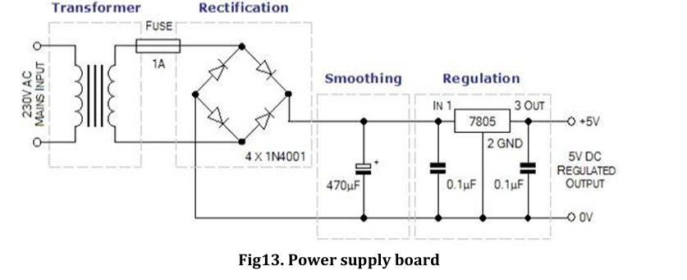
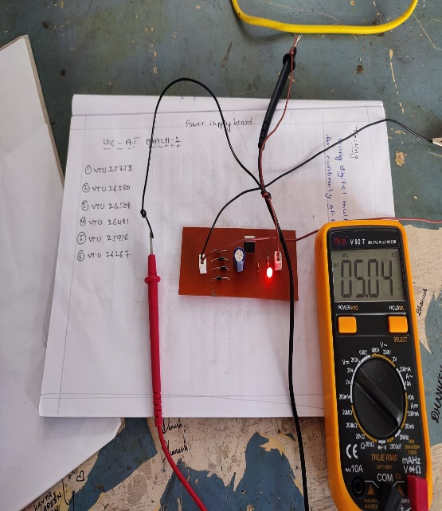
ELECTRONICS:POWER SUPPLY BOARD
Image of the Design Diagram
TOOLS REQUIRED:
1.DIODES
2.CAPACITORS
3.TRANFORMER
4.LED
5..VOLTAGE REGULATOR
6.SINGLE SIDE COPPER
CLAD PCB
7.RILEY BOARD
SKILLS LEARNED:
1.DRILLING
2.SOLDERING
3.IRONING
Image of the completed model

Slide 49
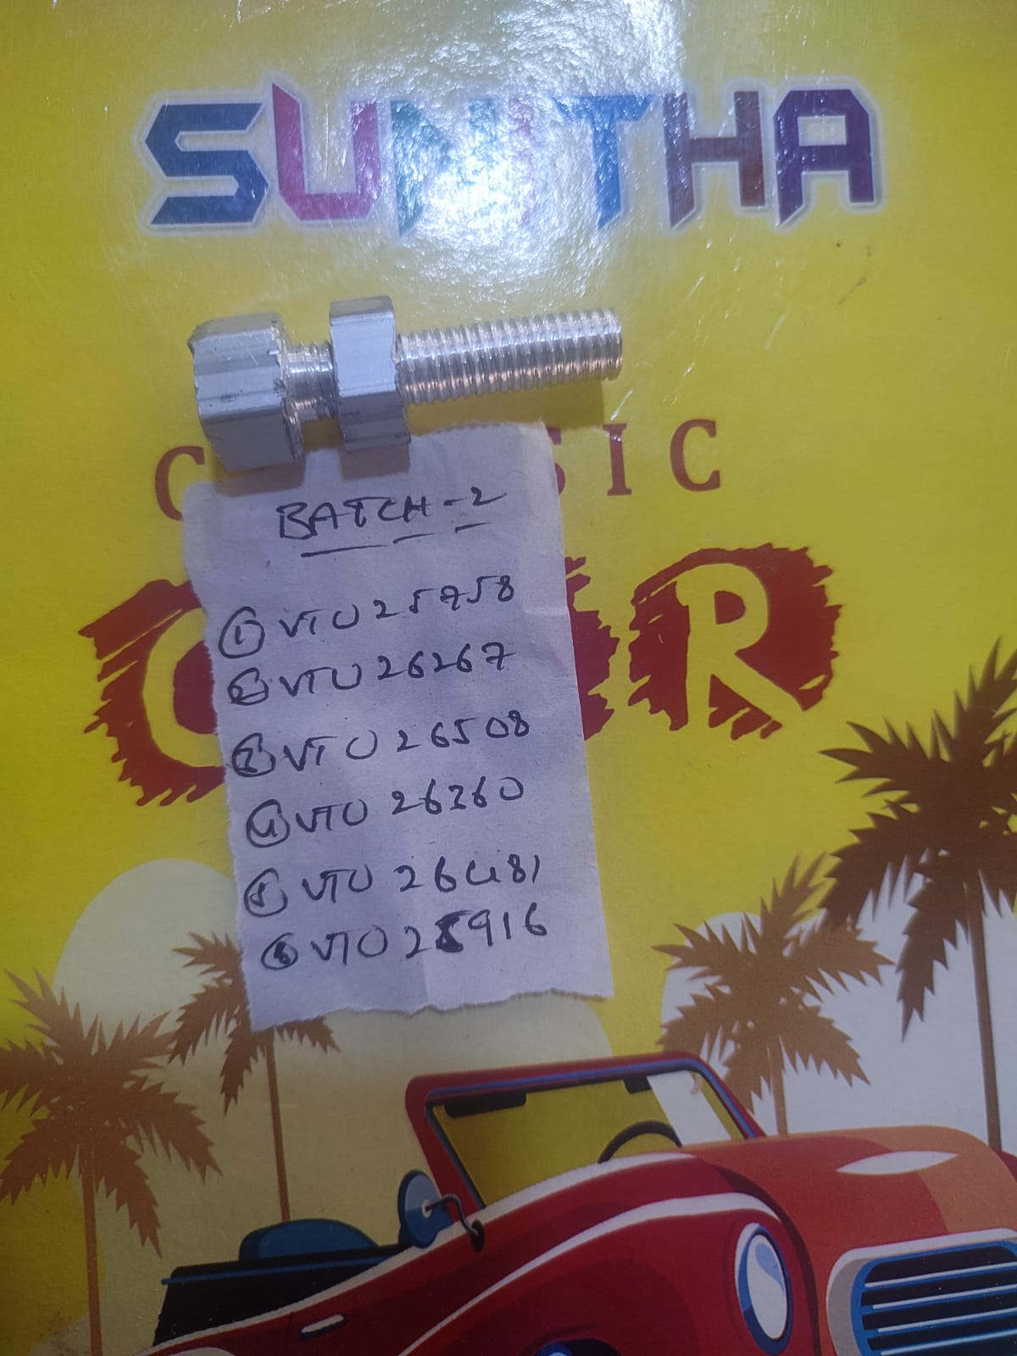
MODEL 3 : POWER SUPPLY BOARD
TOOLS USED:
Steel rule
Outside caliper
Vernier caliper
Flat smooth file
Threading tool
Parting tool
MATERIALS REQUIRED:
Cutting, facing, drilling, knurling, threading, chamfering
SKILLS LEARNED:
we have learnt to measure the metal using caliper and give the threading
Image of the Design Diagram

Slide 50
Thank YOU

